Slide 1
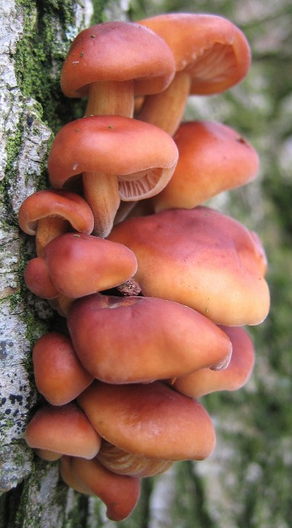

Mining Magnificent Mushrooms
Alison Garrett
A Fun Project Exploring Wild Edibles and Deep Learning
3 December 2021
Flammulina_velutipes: Flew on Space Shuttle Columbia to determine how mushrooms would handle low gravity.

Slide 2
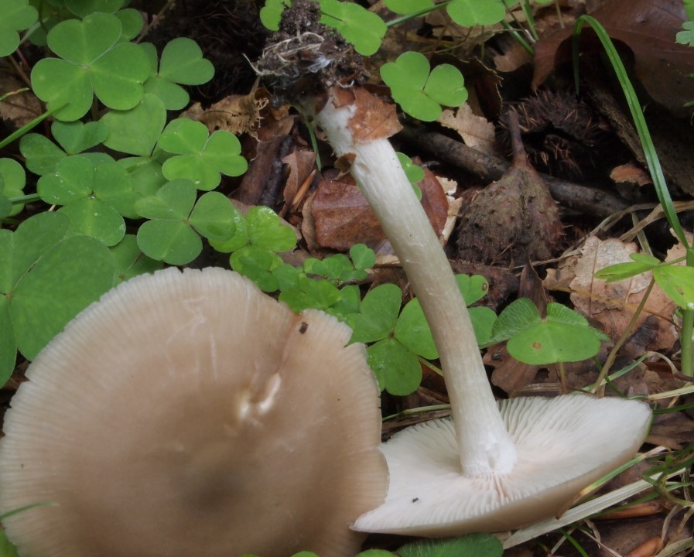

The Case for Foraging
Mushrooms are one of the superfoods, known for health benefits
Unfortunately they can also be highly toxic resulting in illness and even death
Millions of mushroom species, 14,000 described species, ~600 are common and edible
Mushrooms are beautiful wild edibles, even in urban settings
But how do you know, delectable or dangerous?
Entoloma rhodopolium: Finding this mushroom is not quite as lucky as it appears.

Slide 3
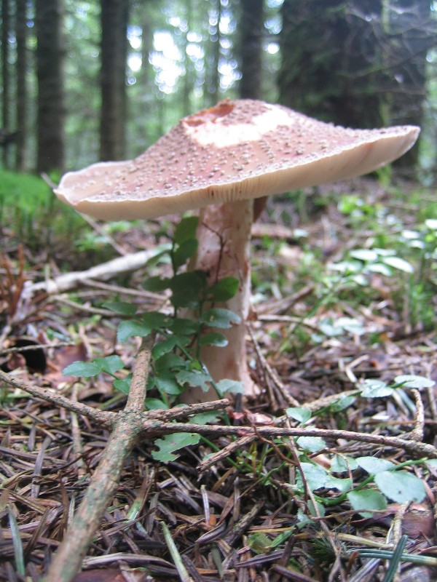
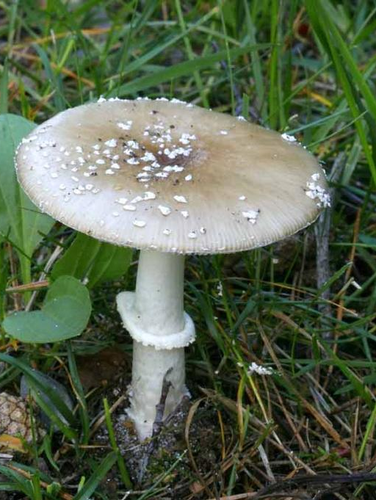
Answering the Question
Classification using University of Copenhagen’s, Natural History Museum of Denmark, Fungi Classification Challenge dataset of 1,394 wild mushrooms species
Selected 41 edible and 44 poisonous common mushrooms, with 7700 images
Edible (Amanita)
Is delectable or dangerous the right question?
What are the characteristics of an edible or poisonous mushroom?
Poisonous (Amanita)

Slide 4
Classification Process
Layer | Layer
Input (32 and 256 batch generator) | (None, 256, 256, 3)
2D Convolution (3,3) | (None, 254, 254, 32)
Activation (ReLU) | (None, 254, 254, 32)
2D MaxPooling | (None, 127, 127, 32)
2D Convolution (3,3) | (None, 125, 125, 32)
Activation (ReLU) | (None, 125, 125, 32)
2D MaxPooling | (None, 62, 62, 32)
2D Convolution (3,3) | (None, 60, 60, 64)
Activation (ReLU) | (None, 60, 60, 64)
2D MaxPooling | (None, 30, 30, 64)
Flatten | (None, 57600)
Dense | (None, 64)
Activation (ReLU) | (None, 64)
Dropout (0.5) | (None, 64)
Dense | (None, 1)
Activation (Sigmoid) | (None, 1)
Loss
Binary Cross Entropy
Optimizer
RMSprop
Adam
Metrics
Accuracy
Epochs
10 with 100 steps per epoch
50 full epochs
Transfer Learning
VGG16 with ImageNet weights
ResNet50 with ImageNet weights
Transfer
Learning

Slide 5
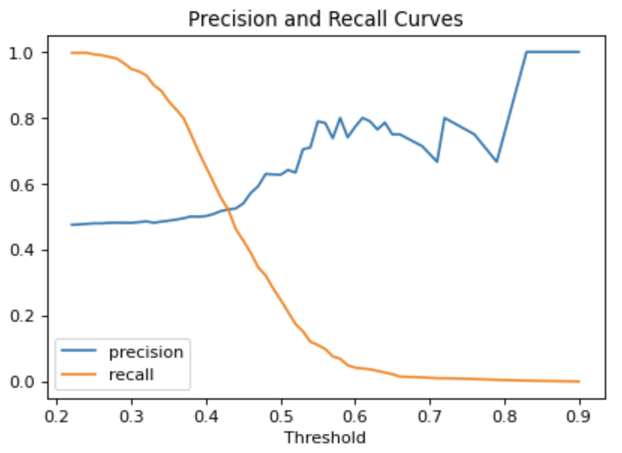
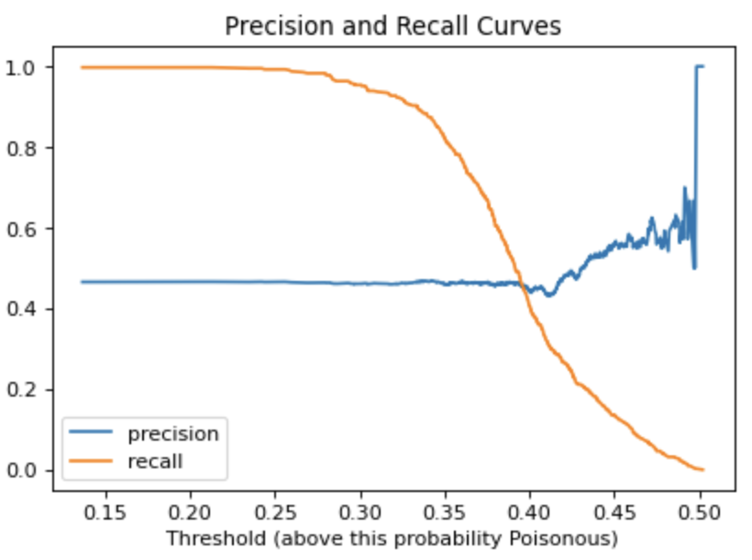
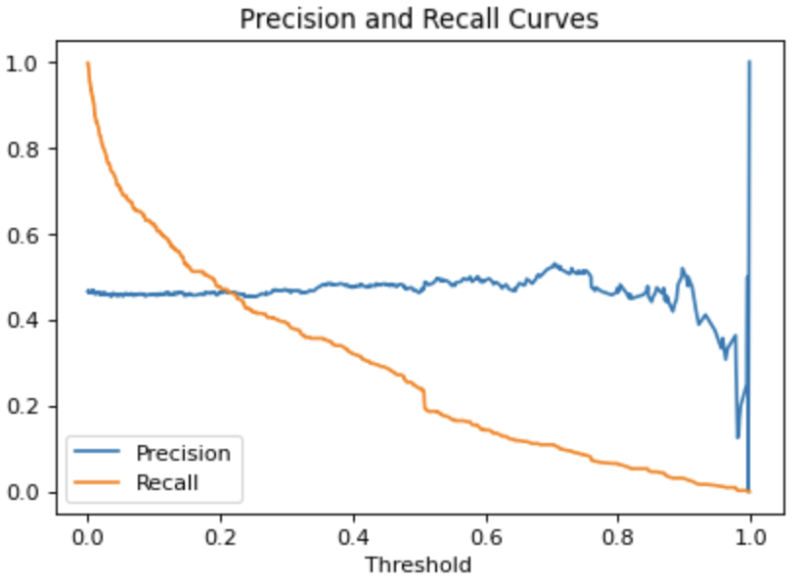
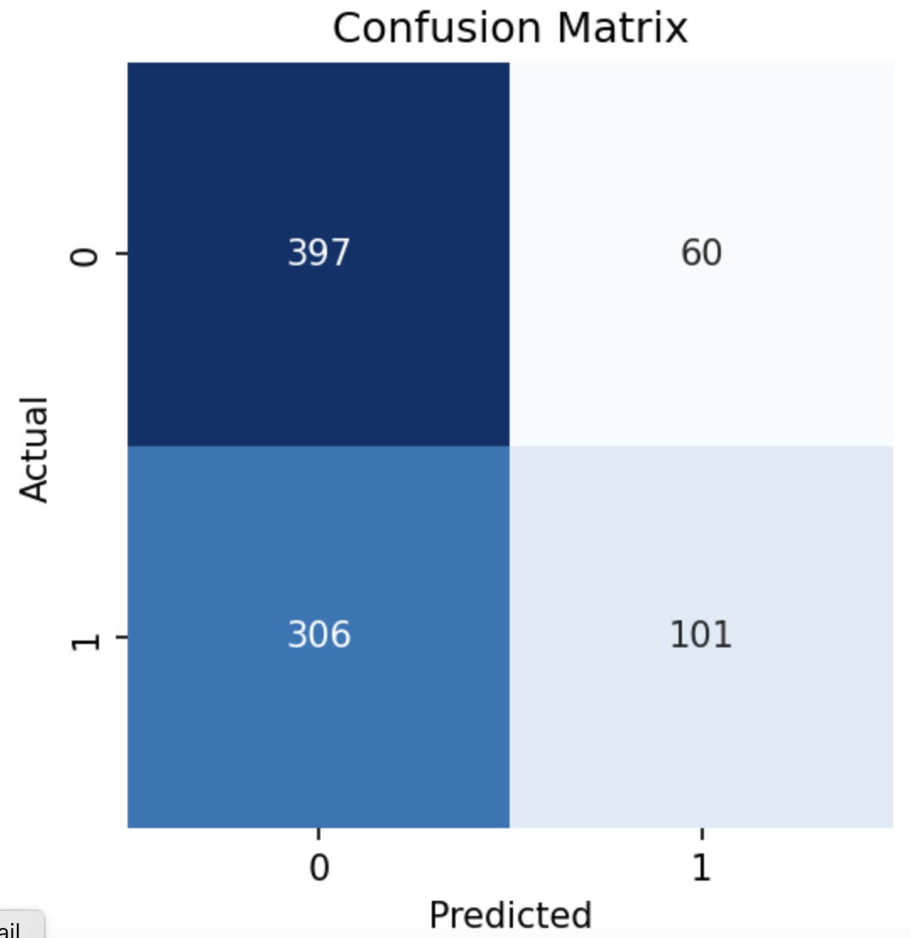
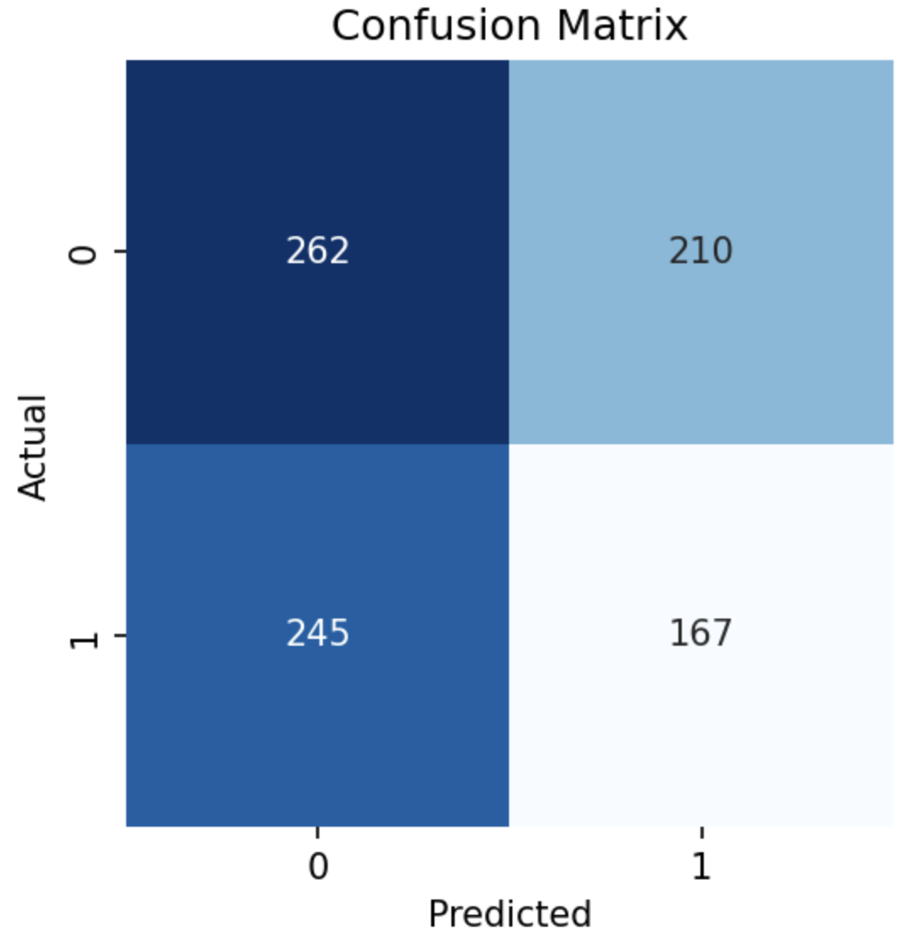
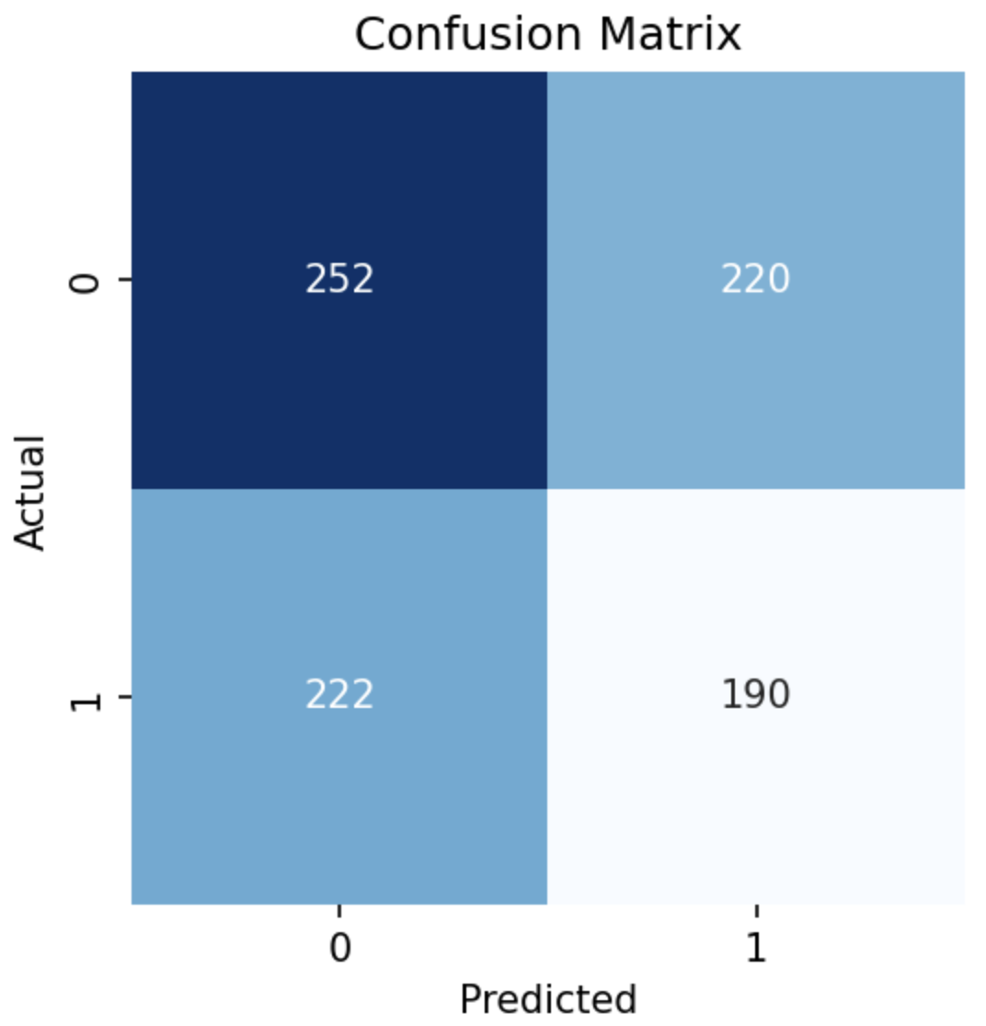
Delectable or Dangerous
Baseline Random Forest
Custom CNN
Transfer Learning
Random Guess!
Threshold: 0.4 ROC AUC: 0.558
Threshold: 0.4 ROC AUC: 0.480
Threshold: 0.22 ROC AUC: 0.507

Slide 6
Conclusions and Next Steps
None of the models learned the images sufficiently to classify edible or poisonous
As anticipated, the project design may be flawed
Very difficult to classify edible or poisonous without understanding the mushroom categorization
Using the upcoming module on cloud computing to handle the processing
Develop a by Genus and Species classification model
Map the Genus and Species to Delectable or Dangerous
Until then, don’t go mushroom foraging with Alison

Slide 7
References
Slide Master Photo by Lukasz Szmigiel on Unsplash
MushroomExpert.com and Mushroom Council Fun Facts
Wikipedia Edible Mushrooms and Poisonous Mushrooms
University of Copenhagen, Natural History Museum of Denmark Fungi Classification Challenge Images
Yummy
Oops

